Slide 1
CRUD and Query in MongoDB

Slide 2
MongoDB
Is a document database
Data is stored in Collections that are similar to SQL table in RDB
A collection has many documents that are equivalent to records in RDB
A key/value pair is similar to a value in a column of a record in RDB
Relational
Database
MongoDB
Database
id | Name | netid
01342 | Alice Smith | Asmith14
012502 | Bob Willams | bwilli21
students {
{
“id”: 01342,
“name”: “Alice Smith”,
“netid”: “asmith14”
},
{
“id”: 12502,
“name”: “Bob William”,
“netid”: “bwilli21”
}
}
Collection 2 {
{
field 1: value 1,
field 2: value 2,
…
},
{
field 1: value 1,
field 2: value 2,
…
}
}

Slide 3
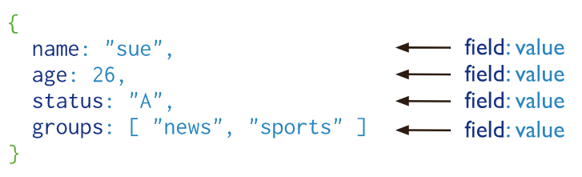
MongoDB Document
Refer to one “record” in relational database
Stored as a set of field : value pairs (like key : value in dictionaries)
A document example is as below. It has four fields: name, age, status, and groups.
retrieved from https://docs.mongodb.com/manual/introduction/
More information in https://docs.mongodb.com/manual/core/document/

Slide 4
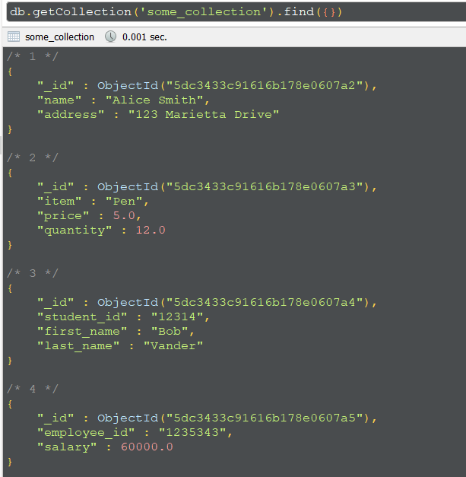
MongoDB Collection
Somewhat similar to a RDBMS table
Stores documents (potentially of the same types)
Unlike a table, MongoDB collections do not have fix schema (meaning a fixed set of columns).
Records in the same collections may have totally different fields (though not exactly recommended)

Slide 5
Interacting with MongoDB Database
Switch database with use <database name>
Most data operations are done with the syntax
db.<collection>.<function>()
<collection> is the name of the collection
<function> is the function that perform the operation
Example:
use test
db.test.insert({“id”:1,”name”:”test 1”})

Slide 6
CRUD Operations
CRUD stands for Create – Read – Update – Delete, the four basics operations on data of any database system
I will compare to SQL statements for them. Detail explanations come in next slides
Operation | RDBMS SQL Statement | MongoDB Equivalent
Create | CREATE TABLE test (id INT, name VARCHAR(20)); | db.createCollection(“test”)
Create | INSERT INTO test VALUES (1,”test 1”); | db.test.insert({“id”:1,”name”:”test 1”})
Read | SELECT * FROM test; | db.test.find()
Read | SELECT * FROM test WHERE id=1; | db.test.find({“id”:1})
Update | UPDATE test SET name = “test 2” WHERE id=1; | db.test.update({“id”:"1234534”}, {$set: {“name":”test 2”}} , {multi: true});
Delete | DELETE FROM test WHERE id=1; | db.test.drop({“id”:1})

Slide 7
Insert Data
Insert one document:
db.<collection>.insertOne({["<field>":<value>]})
<field> is the name of the field
<value> is the value of the field, string values must be inside quotes
Can have multiple <field>:<value> separated by commas ,
Example
db.people.insertOne({"PID":"000101", "first_name":"Alice", "last_name":"Smith", "age": 30})
Insert multiple documents:
db.<collection>.insertMany([{["<field>":<value>]}])
Similar to insertOne(), however can have multiple documents separated by commas ,
All documents are placed in a single [ ]
Example
db.people.insertMany([
{"PID":"000234","first_name":"Carol","last_name":"Brown", "age": 25},
{"PID":"000236","first_name":"Daniel","last_name":"Davis", "age": 35}
])

Slide 8
Query data
General syntax: db.<collection>.find({<field>:<criteria>})
Examples:
Get everything: db.people.find()
Find people with age = 36: db.people.find("age": 36)
Find people with first name similar to “Emm”: db.people.find("first_name": /Emm/)
For comparison, the criteria has the form {<operator>: <value>}
Operators: $eq (=), $gt (>), $gte (>=), $lt (<), $lte (<=)
Examples:
Find people older than 36: db.people.find({"age": {$gte:30}})
Multiple <field>: <criteria> can be put into a single find() which creates an AND operator. The search criteria must be in the same {}
Find people whose first name has “Emm” and older than 23
db.people.find({"first_name": /Emm/, "age": {$gt:23}})
Select field to show in result:
db.<collection>.find({<field>:<criteria>}, {<field_to_show>:1, <field_to_hide>:0})
Find people whose first name has “Emm” and only show their first and last name: db.people.find({"first_name":/Emm/}, {"first_name":1, "last_name":1, _id:0})

Slide 9
Update
Use the update() function. Since we need to find before update, the first argument is similar to find()
db.<collection>.update({<field>:<criteria>}, {$set:{<field>:<new_value>}}
New fields can be added directly in the $set operator
Examples:
db.people.update({"PID":"000101"},{$set:{"last_name":"Jones","age":35,"email":"alice@mail.com"}})
To remove an existing field, use $unset:
{$unset: {<field_to_remove>:1}}
db.people.update({"PID":"1234534"}, {$unset: {"phone.number":1}} , {multi: true})

Slide 10
Delete data
Use the drop() function
db.<collection>.drop({<field>: <criteria>})
Example
db.people.drop({"PID":"1234534"})

Slide 11
More Readings
https://www.mongodb.com/docs/manual/tutorial/getting-started/

